Slide 1
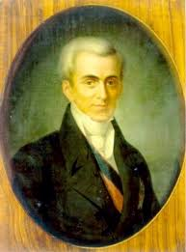
IOANNIS KAPODISTRIAS THE 1ST GOVERNOR OF GREECE
IN PICTURES

Slide 2
“ I’d rather die than cheat the people who have entrusted to my care their own fate”

Slide 3
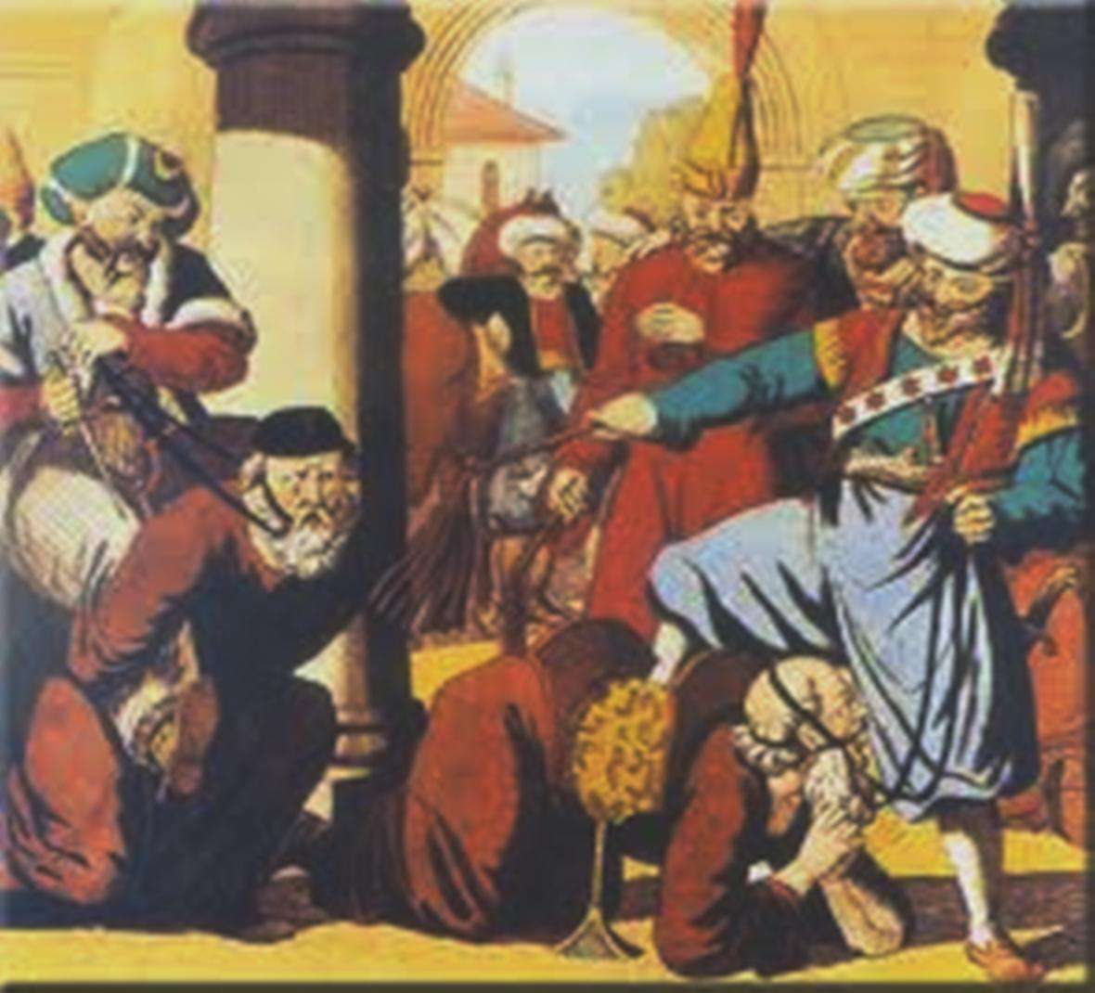
HISTORICAL BACKGROUND: Greece under the Turkish bondage for almost 400 years

Slide 5
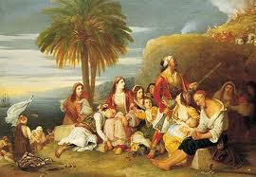
In 1821 the Greek Revolution of Independence started

Slide 6
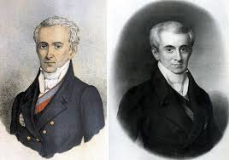
IOANNIS KAPODISTRIAS Ηis early career
Counselor of the Russian state
In Switzerland

Slide 7
HIS ELECTION

Slide 8
The Governorate

Slide 9
The Greek coin that replaced the Turkish one

Slide 10
The Agricultural School

Slide 11
A peer-learning school

Slide 12
His assassination

Slide 14
A GREAT POLITICIAN
“I refuse to ‘touch’ the state’s money, while the country is in ruins and the people are plunged in despair and utter poverty!”

